Slide 1


Green Pace
Security Policy Presentation
Developer: Bryan Rivera

Slide 2

OVERVIEW: DEFENSE IN DEPTH
This policy defines the core security principles; C/C++ coding standards; authorization, authentication, and auditing standards; and data encryption standards.

Slide 3
THREATS MATRIX
Likely [MEM50-CPP] [ERR56-CPP] [MSC51-CPP] | Priority P18 P9 P18
Low priority P1 P4 P1 P6 | Unlikely [DCL12-C] [ERR34-C] [DCL03-C] [DCL58-CPP]

Slide 4
10 PRINCIPLES
Validate Input Data
Heed Compiler Warnings
Architect and Design for Security
Keep It Simple
Default Deny
Adhere to the Principle of Least Privilege
Sanitize Data Sent to Other Systems
Practice Defense in Depth
Use Effective Quality Assurance Techniques
Adopt a Secure Coding Standard

Slide 5
CODING STANDARDS
Data Type
Data Value
String Correctness
SQL Injection
Memory Protection
Assertions
Exceptions
Protect access
Properly seeding
Avoid new declarations in namespace std

Slide 6
ENCRYPTION POLICIES
Encryption in rest is when data is converted into another form of data when not in use
Encryption at flight is when the data is being encrypted while it is being transmitted over a network
Encryption in use is an approach where data is never left unsecured

Slide 7
TRIPLE-A POLICIES
Authentication is the security process that the network of application identifies the authenticity of the user to avoid unauthorized access through user logins and avoid the addition of new users
Authorization is the process where it enforces policies of determining the user level of access to avoid unauthorized actions and changes to the database
Accounting is the process that measure the action the users do and what files access by users.

Slide 8
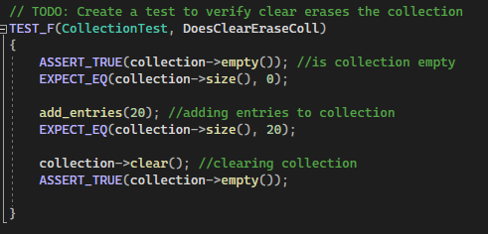
Unit Testing

Slide 9
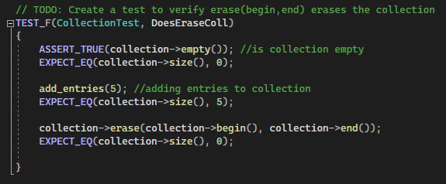
Unit Testing

Slide 10
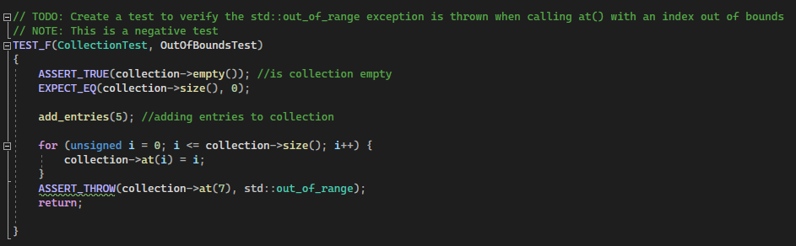
Unit Testing

Slide 11
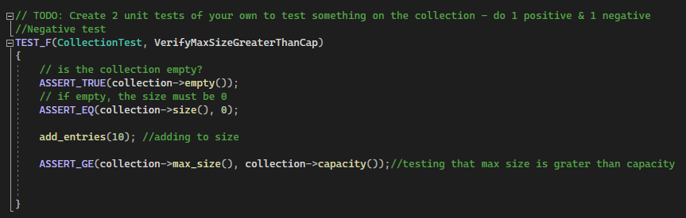
Unit Testing

Slide 12

AUTOMATION SUMMARY

Slide 13
TOOLS
The automation should be made at the Verify and test stage. This gives the automation a set goal and to find vulnerabilities, trusted sources, compliancy, and security testing in the pre-production. This helps with letting the automation catch errors and security issues early on in the cycle. By having this in the early stage it helps the company save money and focus on the other parts of the project.

Slide 14
RISKS AND BENEFITS
It is good practice to dispose of information that the company doesn’t need to keep because the less information the company had of their clients the less information the attacker will acquire if there is a data breach and information is stolen. Steps that should be taken to prevent threats are the start with security, control access to data sensibly, require secure passwords and authentication, store sensitive personal information securely and protect it during transmission, segment your network and monitor who’s trying to get in and out, secure remote access to your network, apply sound security practices when developing new products, make sure your service providers implement reasonable security measures, put procedures in place to keep your security current and address vulnerabilities that may arise, and secure paper, physical media, and devices.

Slide 15
RECOMMENDATIONS
Gaps in the security policy is that coding is always going to change and improve and that security that we put into our codes might be obsolete soon because of these changes. There always must be updates to security and to make it less prone to attacks. According to this article, “Consequently, even if source code has been designed to defend against attacks that exploit vulnerabilities in these aspects of a computer system, an optimizing compiler is not guaranteed to preserve those defense mechanisms” (2015, May 1). There will always be a gap in security policy in a near future because of the changes made to source code and compilers.

Slide 16
CONCLUSIONS
Standards that should be adopted to prevent future problems are turning daily backups into and instinct will help by preventing huge data losses by “save code daily, and after every modification, no matter how minuscule it may be” (2021, February 2), leaving comments and prioritize documentation, and try to formalize Exception Handling.

Slide 17
REFERENCES
The Correctness-Security Gap in Compiler Optimization. (2015, May 1). IEEE Conference Publication | IEEE Xplore. https://ieeexplore.ieee.org/abstract/document/7163211
Bose, S. (2021, February 2). Coding Standards and Best Practices To Follow. BrowserStack. https://www.browserstack.com/guide/coding-standards-best-practices

